Slide 1
Front End Web Development
Topic 7:
JavaScript – Part II
Notes:
NCC Education - Title Master

Slide 2
Scope and Coverage
This topic will cover:
DOM introduction
DOM elements
DOM attributes
JS events
Notes:
NCC Education - Slide Master

Slide 3
Learning Outcomes
By the end of this topic students will be able to:
Explain DOM concepts
Explain DOM elements and attributes
Describe event listening concepts
Write and apply programming skills for DOM and JS events

Slide 4
Unit Roadmap
Week | Topic | Week | Topic
1 | Overview of Web Application Architecture | 7 | JavaScript - II
2 | Introduction to HTML5 | 8 | jQuery
3 | Introduction to CSS | 9 | Responsive CSS Framework: Bootstrap –I
4 | HTML and CSS | 10 | Responsive CSS Framework: Bootstrap –II
5 | CSS Flexbox and Grid Layout | 11 | Code Review and Testing. and Collaboration
6 | JavaScript - I | 12 | Unit Summary

Slide 5
DOM basics

Slide 6
What is the DOM?
DOM == Document Object Model
An application programming interface (API) for HTML as well as XML.
The DOM represents an entire web page as a document, composed of a hierarchy of nodes.
Each node corresponds to a part of the page (e.g., an element or attribute).
It has the capability to change the appearance and content of a web page without needing to reload the document.
Every component of an HTML or XML page is derived from a node.

Slide 7
DOM Hierarchy
<html>
<head>
<title>Example JS Page</title>
</head>
<body>
<div id=“Rayyan”>
<ul>
<li>Delhi</li>
<li>Mumbai</li>
<li>Chennai</li>
<li>Kolkata</li>
</ul>
</div>
</body>
</html>
The DOM is hierarchical

Slide 8
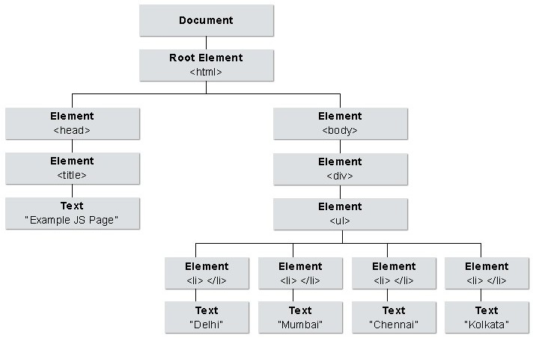
DOM Tree

Slide 9
What is HTML DOM?
The HTML DOM is defined as a standard object model and programming interface for HTML.
It defines the HTML elements as objects, their properties, methods to access them, and events associated with them.
The HTML elements as objects
The properties of all HTML elements
The methods to access all HTML elements
The events for all HTML elements
The HTML DOM provides standards for getting, changing, adding, or deleting HTML elements.

Slide 10
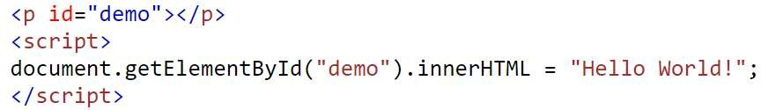
DOM Methods
HTML DOM methods are actions that can be performed on HTML Elements.
HTML DOM properties are values of HTML Elements that can be set or changed.
In the example above, getElementById is a method, while innerHTML is a property.

Slide 11
The HTML DOM Document Object
The document object represents the web page.
It is the starting point for accessing any element in an HTML page.
Finding HTML Elements:
document.getElementById(id)
document.getElementsByTagName(<li>) Find elements by tag name
document.getElementsByClassName(classname) Find elements by class name
Changing HTML Elements:
element.innerHTML
element.setAttribute(att, val)
element.style.property
Find an element by element id
Change the inner HTML of an element Change the attribute value of an element Change the style of an HTML element

Slide 12
DOM Elements Methods
With JavaScript HTML elements can be manipulated.
Methods to manipulate elements:
Finding HTML element by id
const element = document.getElementById("intro");
Finding HTML elements by tag name
const element = document.getElementsByTagName("p");
Finding HTML elements by class name
const x = document.getElementsByClassName("intro");
Finding HTML elements by CSS selectors (querySelectorAll, querySelector)
const x = document.querySelectorAll("p.intro");
Finding HTML elements by HTML object collections
const x = document.forms[‘name’] const x = document.forms[0]
//return form element that has name
//return first form element in webpage

Slide 13
Quiz - 1
1. What does DOM stand for in web development?
A) Dynamic Object Model
B) Document Object Model
C) Display Object Management
2. Which object is the topmost object in the DOM hierarchy?
A) document
B) window
C) HTMLDocument
3. How can you access an element by its ID in the DOM?
A) document.getElement('idname');
B) document.getElementById('idname');
C) document.querySelector('#idname');
Notes:
Correct Answer: B) Document Object Model
Correct Answer: B) window
Correct Answer: B) document.getElementById('idname'); (Note: C is also a valid method, but B directly asks for access by ID, making it the more specific answer for this question.)

Slide 14
Access DOM elements

Slide 15

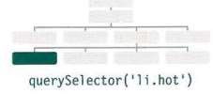
Access An Element
SELECT AN INDIVIDUAL ELEMENT NODE
getElementByld (‘id’)
Selects an individual element given the value of its id attribute.
querySelector(‘ css selector ')
Uses a CSS selector and returns the first matching element.

Slide 16
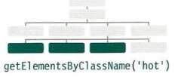

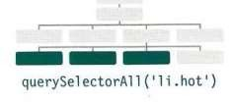
Access Elements
.SELECT MULTIPLE ELEMENTS (NODELISTS)
getElementsByClassName(‘class ‘) Selects all elements that have a specific value for their class attribute.
getElementsByTagName(‘ tagName ‘) Selects all elements that have the specified tag name. (faster than querySelectorAll() )
querySelectorAll ( ‘css selector ‘) Uses CSS selector syntax to select one or more elements and returns all of those that match

Slide 17
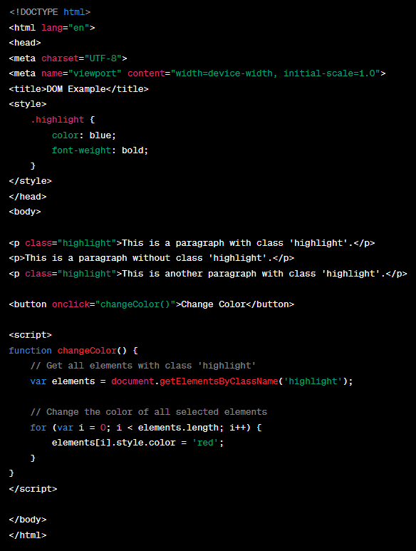
getElementsByClassName()
The getElementsByClassName() method of DOM is used to select all elements with a specified class name.
The method returns a live HTML collection of elements.

Slide 18
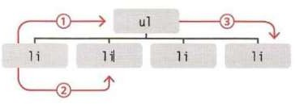
Access The Elements
TRAVERSING BETWEEN ELEMENT NODES
parentNode/parentElement selects the parent of the current element node, providing a pathway upwards in the DOM tree.
previousSibling/nextSibling select adjacent siblings in the DOM tree, allowing lateral navigation among elements.
firstChild/lastChild select the first or last child of the current element, enabling downward traversal in the DOM hierarchy.
These are properties not functions
If no next sibling/first/last child result is null

Slide 19
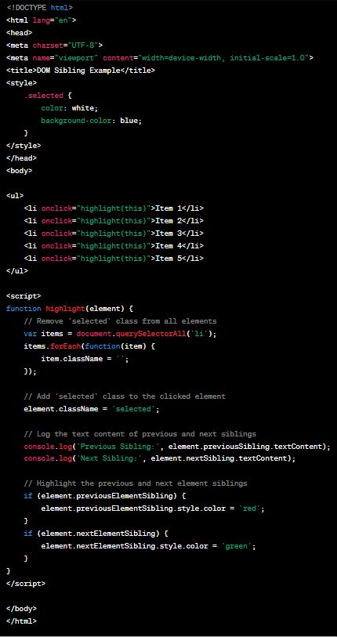
Previous/Next Sibling
nextSibling/previousSibling
return the next and previous siblings, respectively, if there is no whitespace between them.
previousElementSibling/
nextElementSibling
return the next and previous siblings, even if there is space between them.

Slide 20
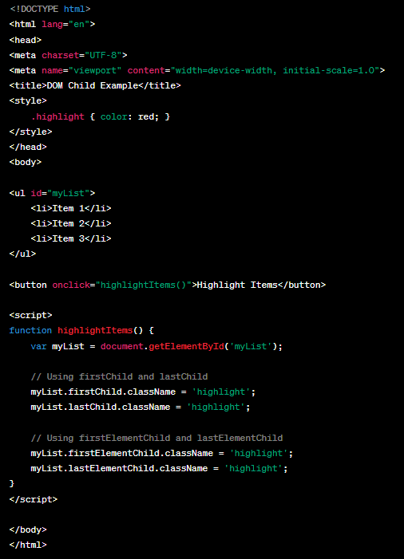
First/Last Child
First/lastchild
provide access to the first and last child nodes, they can return inconsistent or unexpected results if whitespace is present in the HTML, potentially returning text nodes instead of element nodes.
firstElementChild/ lastElementChild
Provide accurate navigation to the first and last child element nodes, disregarding whitespace.

Slide 21
Get/update element

Slide 22

GET/UPDATE Element
The Document Object Model (DOM) allows interaction and manipulation of web pages.
Methods and properties like nodeValue, textContent, innerText, and innerHTML enable developers to get and set content within HTML elements.

Slide 23
GET/UPDATE Element - nodeValue
nodeValue Property
Gets or sets the value of a node and is primarily used with attribute or text nodes.
<!-- HTML -->
<div id="example">Old Content</div>
<script>
// JavaScript
document.getElementById('example').innerHTML = '<p>New <strong> HTML </strong> Content</p>';
</script>

Slide 24
GET/UPDATE Element – textContent and innerText
textContent: Gets or sets the concatenated text content of a node and its descendants.
innerText: Similar to textContent, but observes CSS visibility.
<!-- HTML -->
<p id="example">Hello, <span style="display:none;">invisible</span> world!</p>
<script>
// JavaScript
console.log(document.getElementById('example').textContent); // Output: Hello, invisible world!
console.log(document.getElementById('example').innerText); // Output: Hello, world!
</script>

Slide 25
GET/UPDATE Element – innerHTML
innerHTML Property:
Gets or sets the HTML content within an element.
<!-- HTML -->
<div id="example">Old Content</div>
<script>
// JavaScript
document.getElementById('example').innerHTML = '<p>New <strong> HTML </strong> Content</p>';
</script>

Slide 26
Edit dom elements

Slide 27




Add/Remove Elements
createElement () : creates a new Element node of the specified type.
createTextNode() : creates a new Text node containing the specified text.
appendChild(): adds a node to the end of the list of children of a specified parent node.
removeChild(): removes a child node from a parent node.

Slide 28
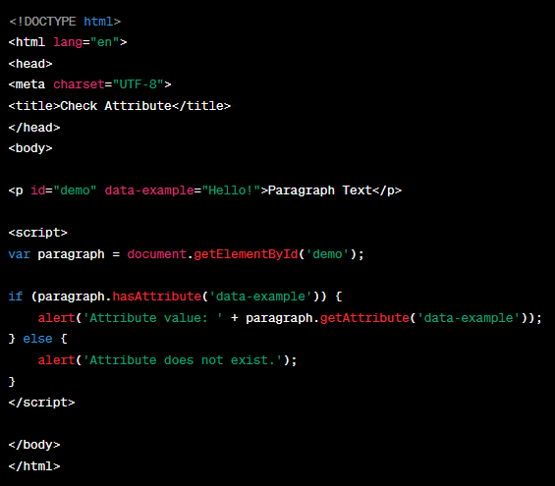
Check Attribute and GET Value

Slide 29
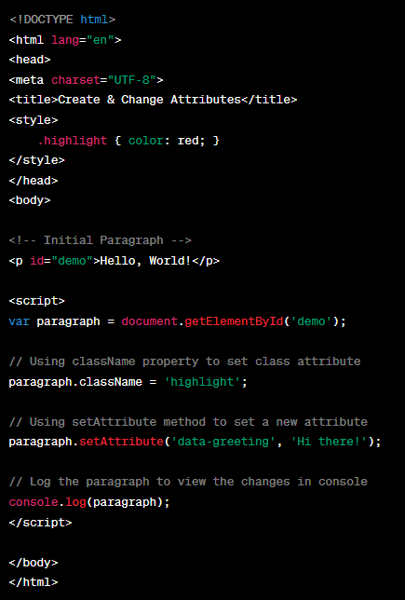
Create/Change Attributes
className: allows to change class of element or add it if not exist.
The setAttribute() method allows you to update the value of any attribute.

Slide 30
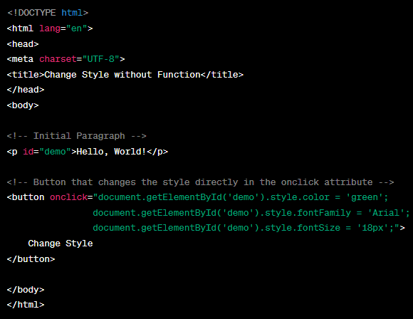
Changing HTML Style
The HTML DOM allows JavaScript to change the style of HTML elements
document.getElementById(id).style.Property = new style

Slide 31
Js events

Slide 32
JS Events
HTML events are occurrences that happen to HTML elements.
When JavaScript is used in HTML pages, JavaScript "reacts" on these events.
An HTML event can be something the browser does, or something a user does.
Here are some examples of HTML events:
An HTML web page has finished loading
An HTML input field was changed
An HTML button was clicked
HTML allows event handler attributes, with JavaScript code, to be added to HTML elements.

Slide 33
Common JS Events
onchange
onclick
onmouseover
onmouseout
onkeydown
onload
An HTML element has been changed
The user clicks an HTML element
The user moves the mouse over an HTML element
The user moves the mouse away from an HTML element The user pushes a keyboard key
The browser has finished loading the page

Slide 34
JS Event Types
load | Web page has finished loading
unload | Web page is unloading (usually when a new page was requested)
error | Browser encounters a JavaScript error, or an asset doesn't exist
resize | Browser window has been resized
scroll | User has scrolled up or down the page
keydown | User first presses a key (repeats while key is depressed)
keyup | User releases a key
keypress | Character is being inserted (repeats while key is depressed)

Slide 35
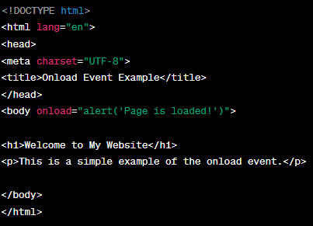
onload Event
The onload event occurs when an object has been loaded.
Commonly used within the <body> element to execute a script once a webpage has fully loaded all content, including images, script files, and CSS files.
onload can be utilized to check the visitor's browser type and version, and load the proper version of the web page based on this information.
onload can also be used to manage cookies.

Slide 36
Mouse Event Types
click | User presses and releases a button over the same element
dblclick | User presses and releases a button twice over the same element
mousedown | User presses a mouse button while over an element
mouseup | User releases a mouse button while over an element
mousemove | User moves the mouse (not on a touchscreen)
mouseover | User moves the mouse over an element (not on a touchscreen)
mouseout | User moves the mouse off an element (not on a touchscreen)

Slide 37
Focus/Form Event Types
FOCUS Events
Focus/focusin | Triggered when an element receives focus
Blur/focusout | Fired when an element loses focus
FORM Events
Submit | Activated when a form is submitted
reset | Fired when a form is reset, either by clicking a reset button or via JavaScript.
change | Triggered when the value of an input or select element is changed and the element loses focus.
input | Fired synchronously when the value of an input, select, or textarea element is altered.
invalid | Occurs when a form field does not meet the validation criteria set in the attributes and form submission is attempted.
select | Triggered when some text is selected in an input or textarea element.

Slide 38
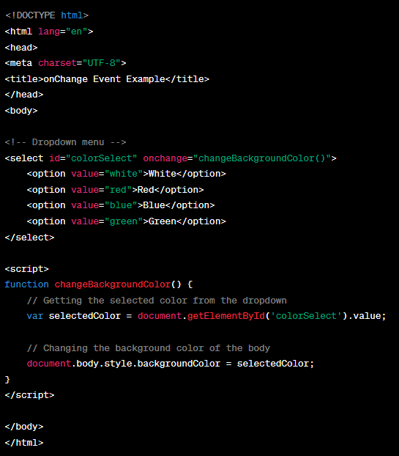
onchange Event
The onchange event occurs when the value of an element has been changed.
For radiobuttons and checkboxes, the onchange event occurs when the checked state has been changed.

Slide 39
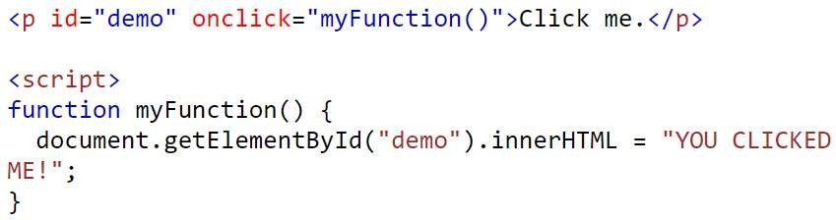
onclick Event
The onclick event occurs when the user clicks on an element.

Slide 40
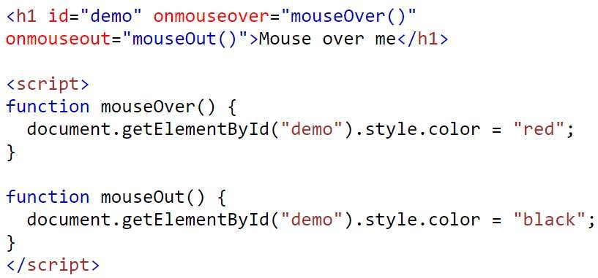
onmouseover / onmouseout Event
The onmouseover event occurs when the mouse pointer is moved onto an element, or onto one of its children.
This event is often used together with the onmouseout event, which occurs when a user moves the mouse pointer out of an element.

Slide 41
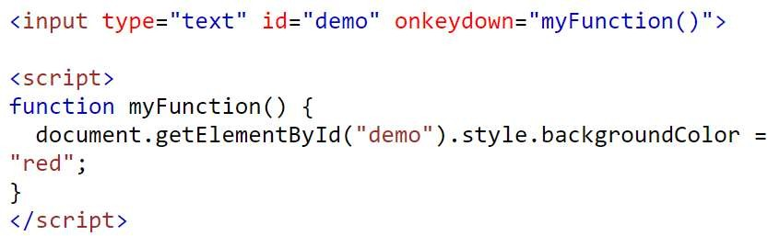
onkeydown Event
The onkeydown event occurs when the user is pressing a key (on the keyboard).

Slide 42
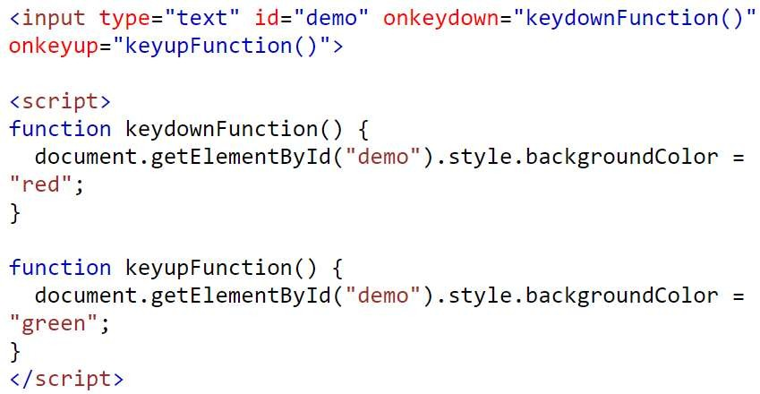
onkeyup Event
The onkeyup event occurs when the user releases a key (on the keyboard).

Slide 43
Traditional DOM Event Handler
Traditional DOM event handlers allows specific functions to be executed in response to particular events on HTML elements.
A limitation of this approach is that only one function can be attached to each event handler.
If an event handler is assigned a new function, it will overwrite any existing function.

Slide 44
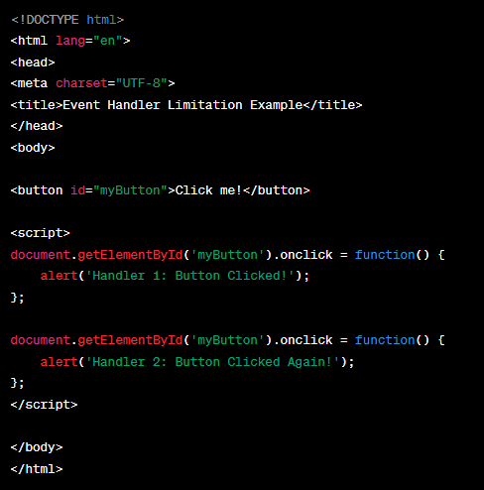
Quiz - Traditional DOM Event Handler
Review the code to explain the traditional DOM event handler

Slide 45
Event Listeners
They can deal with more than one function at a time.
A more flexible approach to managing user interactions and other events.
Event listeners can handle multiple functions in response to a single event.
Create more complex, interactive, and responsive web applications.
Enhances the ability to create layered responses to user interactions by:
Validating inputs
Providing feedback
Manage subsequent actions
Event listeners provide smoother and dynamic user experience.

Slide 46
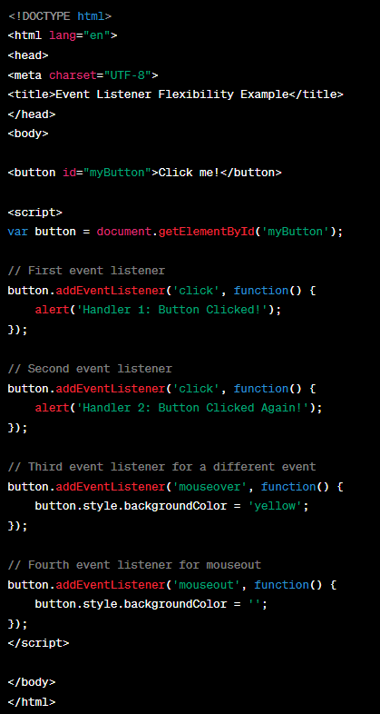
Event Listeners - Example

Slide 47
References
Books
McFarland, D. (2014). JavaScript & jQuery: The Missing Manual. O'Reilly Media.
Freeman, E. (2020). Head First JavaScript Programming: A Brain-Friendly Guide. O'Reilly Media.
Web Resources
Mozilla Developer Network (MDN). Introduction to the DOM. Available at: https://developer.mozilla.org/en-US/docs/Web/API/Document_Object_Model/Introduction
W3Schools. HTML DOM. Available at: https://www.w3schools.com/js/js_htmldom.asp
Eloquent JavaScript. The Document Object Model. Available at: https://eloquentjavascript.net/14_dom.html

Slide 48
Topic 7 – JavaScript II
Any Questions?
Notes:
NCC Education - End Slide Master

